Slide 1

Introduction
to
Computer Science
CS101.3
Pramudya Thilakaratne pramudya.h@nsbm.lk
Lecturer
Faculty of Computing
NSBM Green University

Slide 2
Module Overview
Module Name – Introduction to Computer Science
Module Code – CS101.3
No of sessions per semester – 15 sessions
Session plan – 13 theory sessions / 2 revision sessions
Lecturer – Mr. Pramudya Thilakaratne
Email – pramudya.h@nsbm.lk

Slide 3
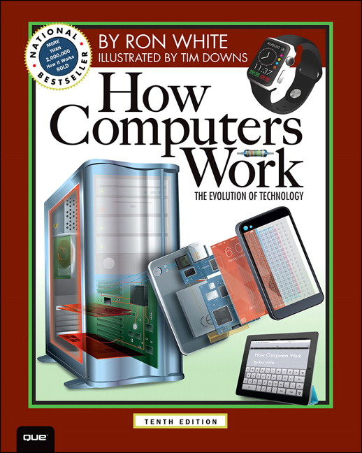
Recommended Textbook for CS101.3
Name How Computer Works
By Ron White
Latest Edition Tenth Edition

Slide 4

Introduction to Computer Science Evaluation Criteria
Final Exam Paper – 60%
Assignment – 20%
Continuous Assignments – 20%
Take home assignments
Spot tests
In class activities
Total – 100%

Slide 5

History of Computers
The first counting device was used by the primitive people.
They used sticks, stones and bones as counting tools.
As human mind and technology improved with time more computing devices were developed.

Slide 6
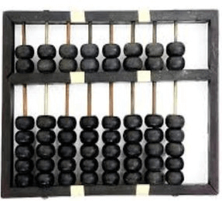
History of Computers Abacus
The history of computer begins with the birth of abacus which is believed to be the first computer.
It is said that Chinese invented Abacus around 4,000 years ago.
It was a wooden rack which has metal rods with beads mounted on them.
The beads were moved by the abacus operator according to some rules to perform arithmetic calculations.

Slide 7
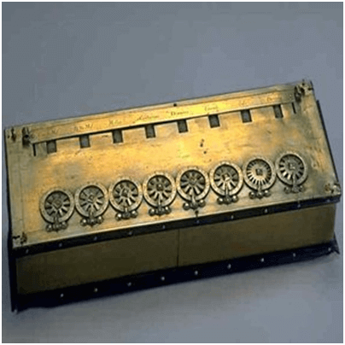
History of Computers Pascaline
Pascaline is also known as Arithmetic Machine or Adding Machine.
It was invented between 1642 and 1644 by a French mathematician-philosopher Biaise Pascal.
It is believed that it was the first mechanical and automatic calculator.
Pascal invented this machine to help his father, a tax accountant.
It could only perform addition and subtraction.

Slide 8
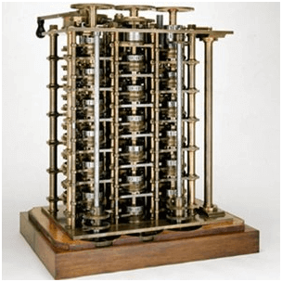
History of Computers Difference Engine
In the early 1820s, it was designed by Charles Babbage who is known as "Father of Modern Computer".
It was a mechanical computer which could perform simple calculations.
It was a steam driven calculating machine designed to solve tables of numbers like logarithm tables.

Slide 9

Quiz
What is the version of the latest Windows Operating System?
Name two other PC based Operating Systems.
What is the latest technology that you know / heard?

Slide 10

Introduction
What is a computer?
Computer is a different type of machine which has,
Speed
ex. High spec computers works faster
Versatility (Scope can be varied)
Computer can be use for certain tasks.
ex. Graphic designing, Web browsing, Word processing etc.
Intelligent
Computer can take its own decisions
ex. ATM machine
Memory
Computer has certain storages
ex. RAM, Hard disk etc.

Slide 11
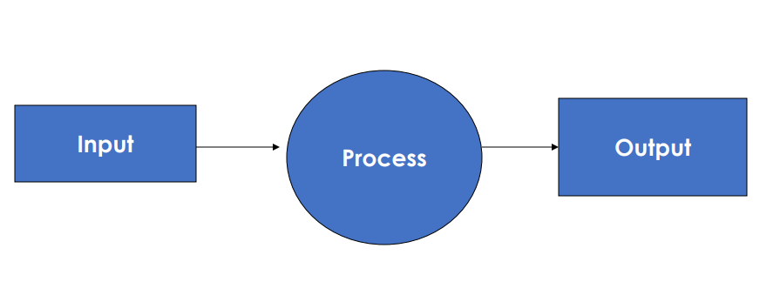
Computer Vs Machine
Architecture of a Typical Machine

Slide 12
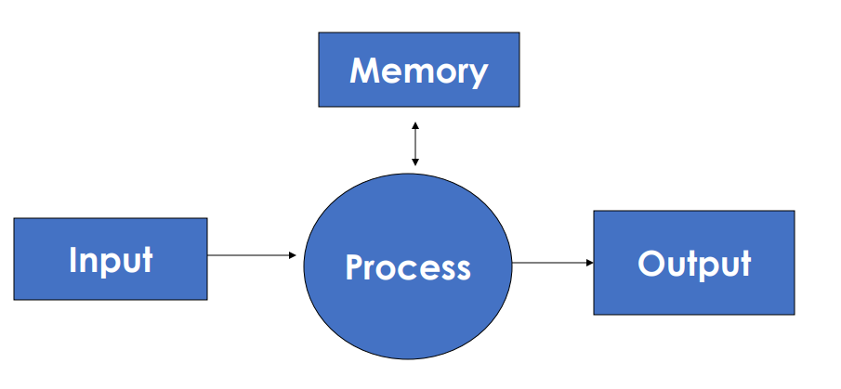
Computer Vs Machine
Architecture of a Computer

Slide 13
Parts of a Computer
Computer consist with two components
Hardware (H/W)
All tangible (Physical) parts of the computer
ex. Cables, Disk, RAM, Motherboard
Software (S/W)
All intangible parts of the computer
ex. MS PowerPoint, MS Word, Web browsers

Slide 14
Parts of a Computer
Hardware can be further divided into
Input Devices
Keyboard
Mouse
Barcode Reader
Scanner
Output Devices
Monitor
Printer
Speaker
Earphone

Slide 15
Parts of a Computer
When considering computer software, it can be further divided into
System Software
System software is also known as Operating System which helps to load the basic program automatically as soon as the computer is started.
Application Software
The software which can be used on an installed operating system.

Slide 16
Central Processing Unit (CPU)
A central processing unit, also called a central processor or main processor, is the electronic circuitry within a computer that executes instructions that make up a computer program.
The CPU performs basic arithmetic, logic, controlling, and input/output operations specified by the instructions.

Slide 17
Types of Processor
Single Core Processor
Single Core processor is a microprocessor with a single core on a chip, running a single thread at any one time.
Dual Core Processor
Dual core processor contains two processors or two execution cores in the same integrated circuit.
Quad Core Processor
Quad core processor is a chip with four independent units called cores.

Slide 18


